Slide 1
Sparse Learning on GWAS
Dhananjay
Poorva
Subhranil
Mansi

Slide 2
Dataset Description
Simulated Dataset, 100 observations, varying the number of SNPs by 500, 1000 and 2000
Predictor variable calculated by applying a weight matrix with 10 non zero values and passing through logistic function with a cutoff value of 0.5.
These 10 values can be thought of as the "active" SNPs in a dataset.

Slide 3
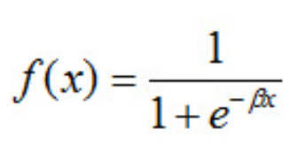



Approach 1: Generalized Linear Models
Any distribution of the form can be considered as a member of the exponential family
GLM models can be solved by newton method with the following formula
Bayesian Treatment can also be performed by Laplace Approximation

Slide 4
GLM implementation in R
R package available in base version
Can be used to calculate weight vector and their corresponding p values
We will observe that the model fails to converge when number of observations<< number of SNPs

Slide 5
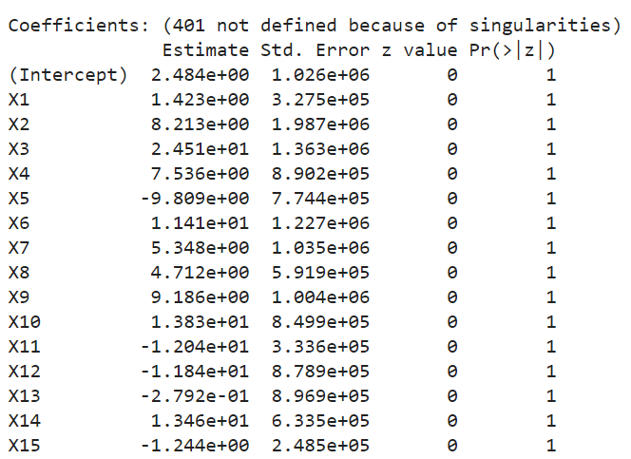
Coefficients
N = 100

Slide 6
GLM Model Results
Conf matrix (p = 500) | positive | negative
positive | 15 | 12
negative | 11 | 12
Overall accuracy (p=500): 0.54
Overall accuracy (p=1000): 0.54
Overall Accuracy (p=2000): 0.54
Most coefficient p values were either 1 or NA values
Conf matrix (p = 1000) | positive | negative
positive | 15 | 12
negative | 11 | 12
Conf matrix (p = 2000) | positive | negative
positive | 15 | 12
negative | 11 | 12

Slide 7

Approach 2: LASSO Regression
If a regression model uses the L1 Regularization technique, then it is called Lasso Regression.
L1 regularization adds a penalty that is equal to the absolute value of the magnitude of the coefficient. This regularization type can result in sparse models with few coefficients.
The formula of Lasso Regression is as follows:
Residual Sum of Squares + λ * (Sum of the absolute value of the magnitude of coefficients)
Notes:
λ denotes the amount of shrinkage.
λ = 0 implies all features are considered and it is equivalent to the linear regression where only the residual sum of squares is considered to build a predictive model
λ = ∞ implies no feature is considered i.e, as λ closes to infinity it eliminates more and more features
The bias increases with increase in λ
variance increases with decrease in λ

Slide 8
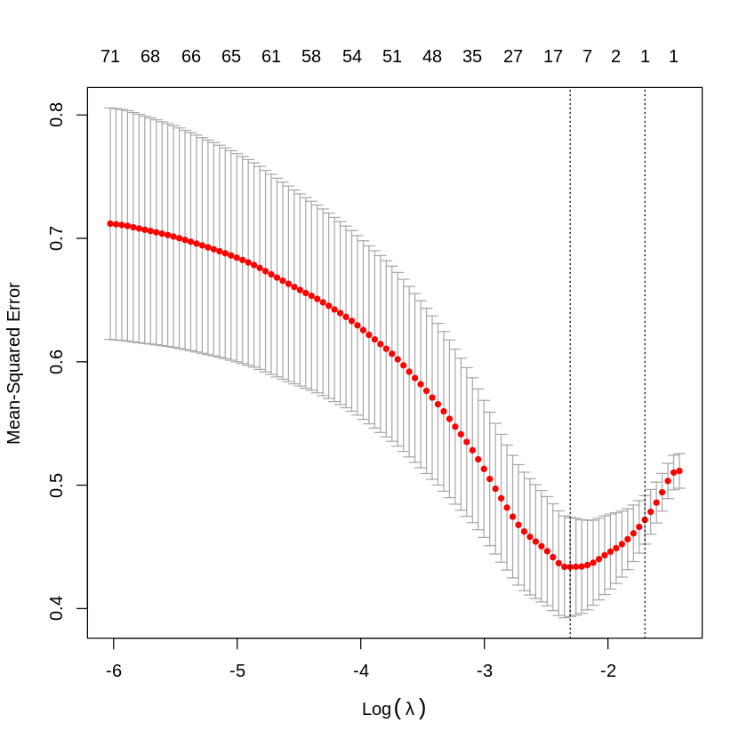
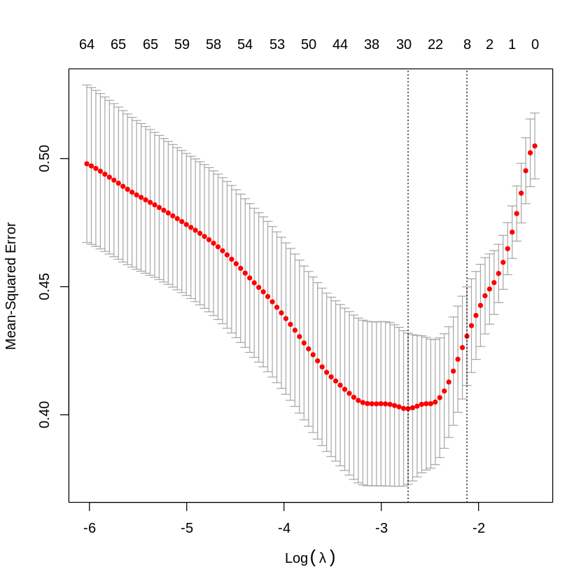
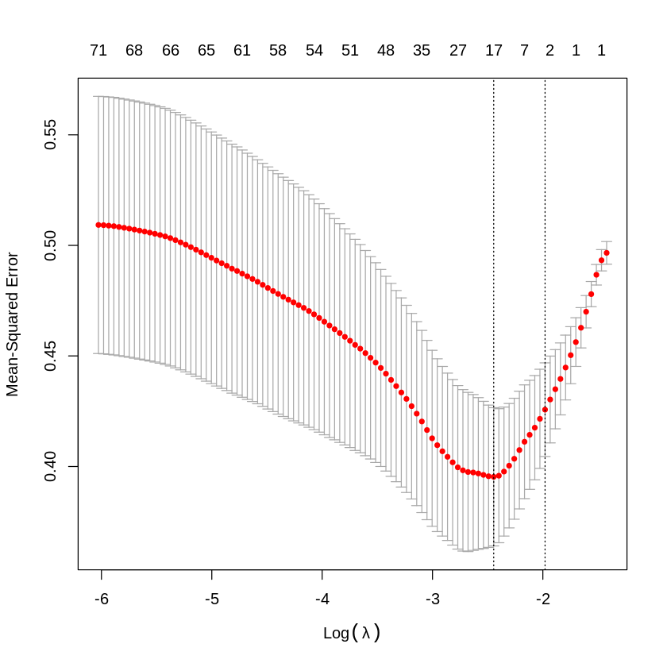
LASSO Hyperparameter tuning
P = 500
Ideal Lambda value 0.1317
P = 1000
Ideal Lambda value 0.12008
P = 2000
Ideal Lambda value 0.1380

Slide 9
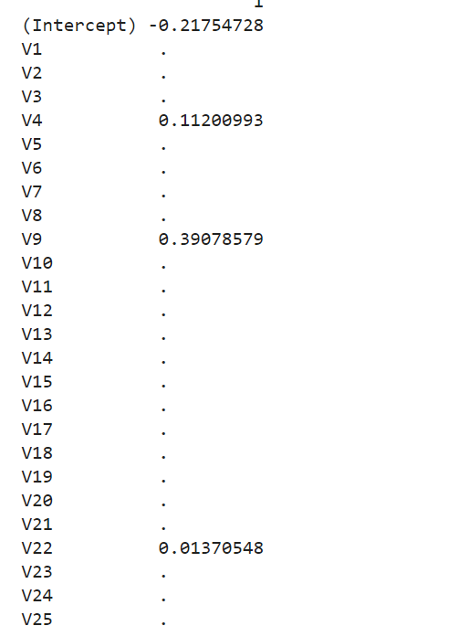
Selected coefficient sample (p=500)

Slide 10
LASSO Model Results
 | positive | negative
positive | 15 | 12
negative | 11 | 12
Conf matrix (p = 500) | positive | negative
positive | 23 | 12
negative | 3 | 12
Overall accuracy(p=500): 0.7
Number of non-zero coefficients(p = 500): 5
Overall Accuracy(p=1000): 0.68
Number of non-zero coefficients(p=1000): 8
Overall Accuracy(p=2000): 0.7
Number of non-zero coefficients(p=2000): 4
Conf matrix (p = 1000) | positive | negative
positive | 23 | 13
negative | 3 | 11
Conf matrix (p = 2000) | positive | negative
positive | 23 | 12
negative | 3 | 12

Slide 11
Approach 3: RIDGE Regression
If a regression model uses the L2 Regularization technique, then it is called Ridge Regression.
L2 regularization adds a penalty that is equal to the square of the magnitude of the coefficient. This regularization type will reduce unimportant coefficients but not necessarily send them to 0

Slide 12
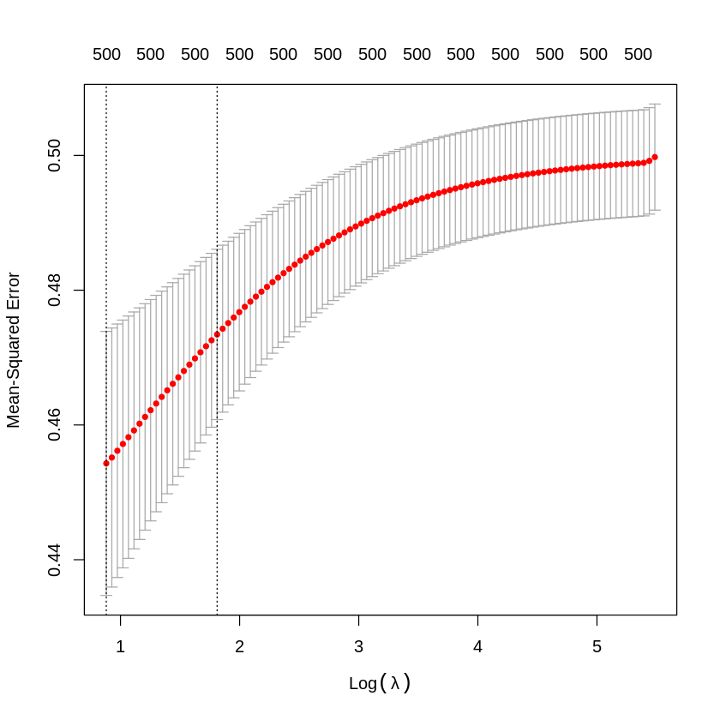
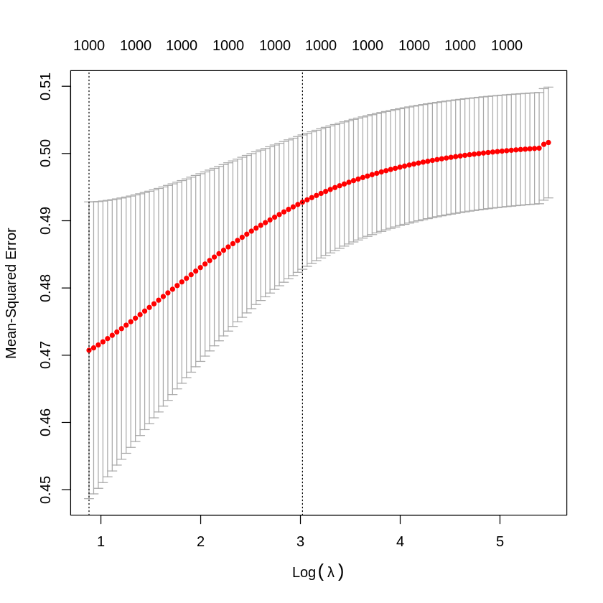
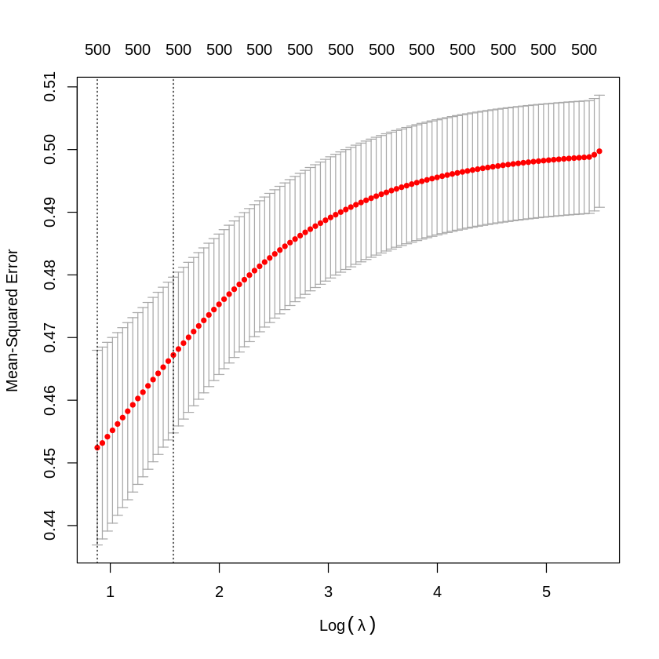
RIDGE Hyperparameter tuning
P = 500
Ideal Lambda value 5.83
P = 1000
Ideal Lambda value 20.5019
P = 2000
Ideal Lambda value 4.8476

Slide 13
RIDGE Model Results
 | positive | negative
positive | 15 | 12
negative | 11 | 12
Conf matrix (p = 500) | positive | negative
positive | 24 | 18
negative | 2 | 6
Overall accuracy(p=500): 0.6
Overall Accuracy(p=1000): 0.52
Overall Accuracy(p=2000): 0.64
Conf matrix (p = 1000) | positive | negative
positive | 0 | 1
negative | 26 | 24
Conf matrix (p = 2000) | positive | negative
positive | 24 | 16
negative | 2 | 8

Slide 14
Approach 4: Elastic Net Regression
Elastic net linear regression uses the penalties from both the lasso and ridge techniques to regularize regression models. The technique combines both the lasso and ridge regression methods by learning from their shortcomings to improve the regularization of statistical models.
The elastic net method improves lasso’s limitations, i.e., where lasso takes a few samples for high dimensional data.
To eliminate the limitations found in lasso, the elastic net includes a quadratic expression (||β||2) in the penalty, which, when used in isolation, becomes ridge regression. The quadratic expression in the penalty elevates the loss function toward being convex. The elastic net draws on the best of both worlds – i.e., lasso and ridge regression.

Slide 15
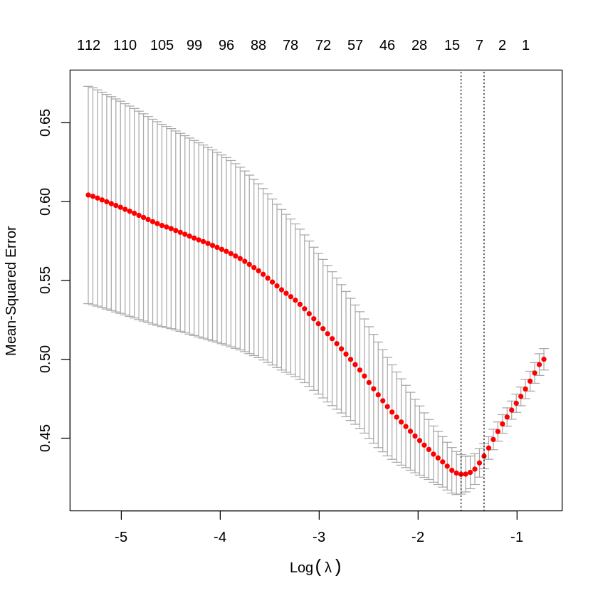
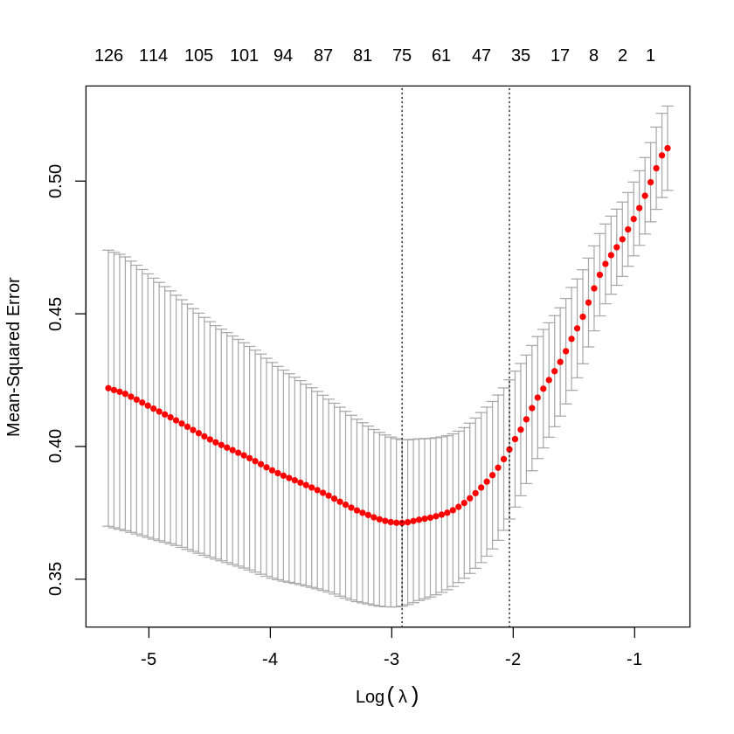
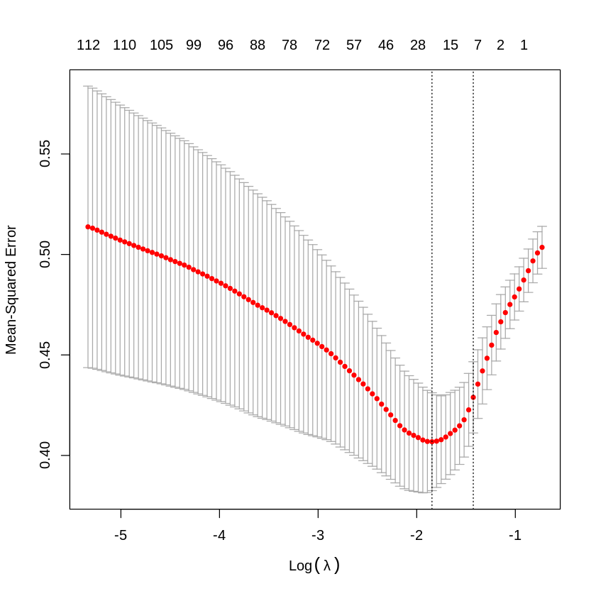
Elastic Net Hyperparameter tuning
P = 500
Ideal Lambda value 0.2516
P = 1000
Ideal Lambda value 0.13118
P = 2000
Ideal Lambda value 0.2401

Slide 16
ELASTIC NET Model Results
 | positive | negative
positive | 15 | 12
negative | 11 | 12
Conf matrix (p = 500) | positive | negative
positive | 25 | 15
negative | 1 | 9
Overall accuracy(p=500): 0.7
Selected Coefficients: 8
Overall Accuracy(p=1000): 0.68
Overall Accuracy(p=2000): 0.72
Conf matrix (p = 1000) | positive | negative
positive | 25 | 15
negative | 1 | 9
Conf matrix (p = 2000) | positive | negative
positive | 26 | 14
negative | 0 | 10

Slide 17
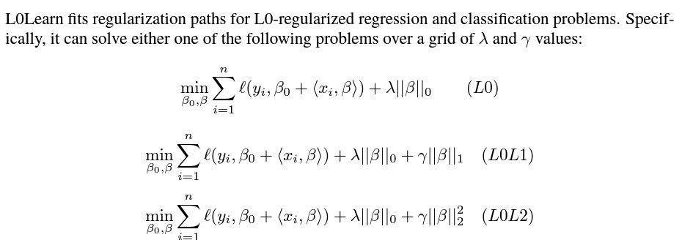
Approach 5: L0-Regularized Regression
Here l is the loss function. It can be one of squared error, logistic or squared hinge loss.
Lambda is regularization parameter of L0 loss, where L0 loss is determined by the number of non-zero coefficients
Gamma is regularization parameter of L1 or L2 loss added to the loss function
The optimization problem is solved by coordinate descent

Slide 18
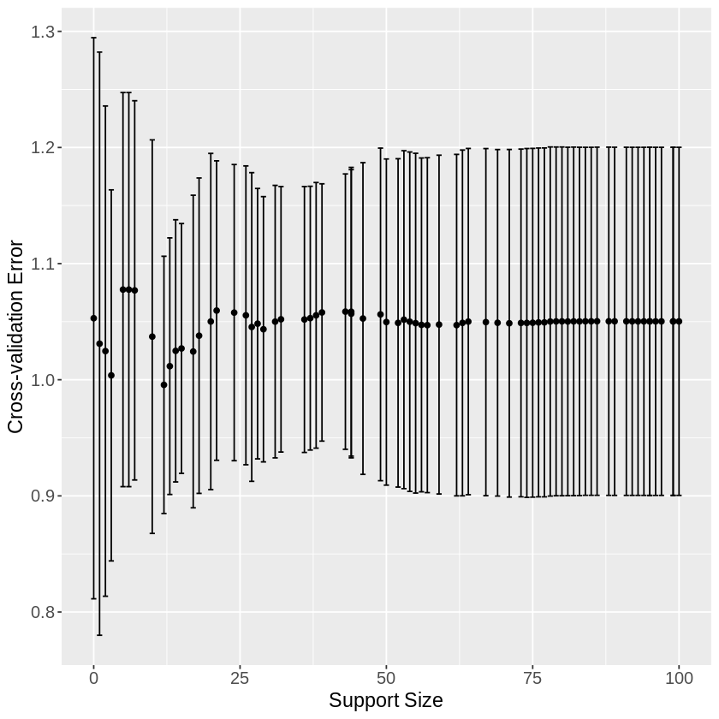
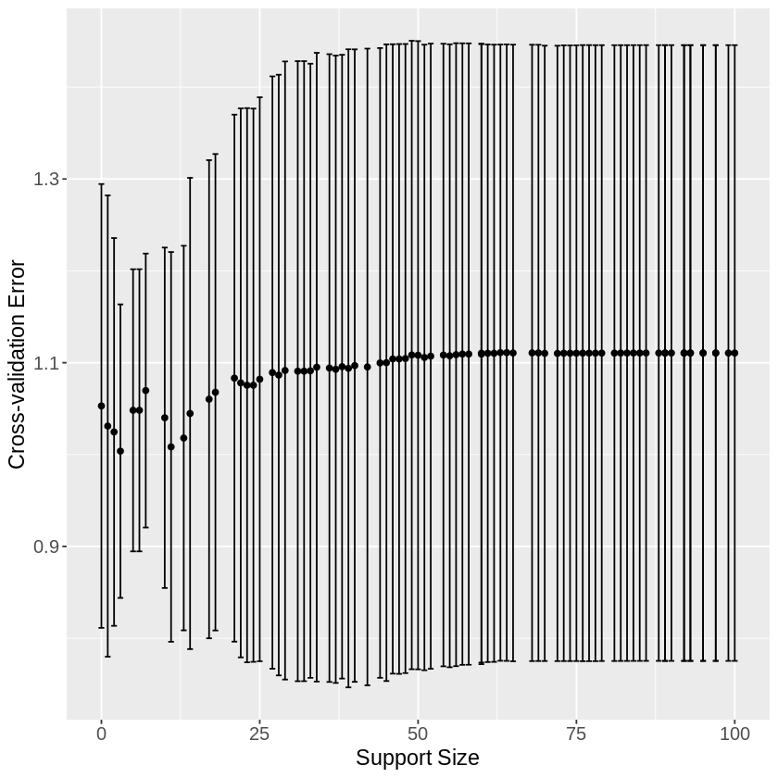
Hyperparameter tuning: L0 Penalty
P = 500
Ideal Lambda value 0.01888
P = 1000
Ideal Lambda value 0.01888
P = 2000​
Ideal Lambda value 0.01888

Slide 19
L0 Regularization Model Results
 | positive | negative
positive | 15 | 12
negative | 11 | 12
Conf matrix (p = 500) | positive | negative
positive | 25 | 1
negative | 1 | 23
Overall accuracy(p=500): 0.96
Overall Accuracy(p=1000): 0.96
Overall Accuracy(p=2000): 0.96
Conf matrix (p = 1000) | positive | negative
positive | 25 | 1
negative | 1 | 23
Conf matrix (p = 2000) | positive | negative
positive | 25 | 1
negative | 1 | 23

Slide 20
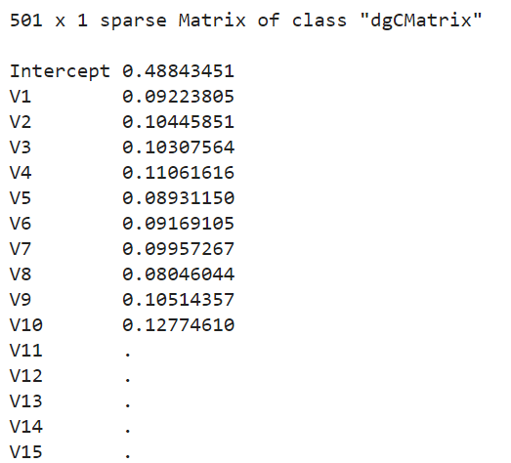
Coefficient Comparison
L0Learn
LASSO

Slide 21
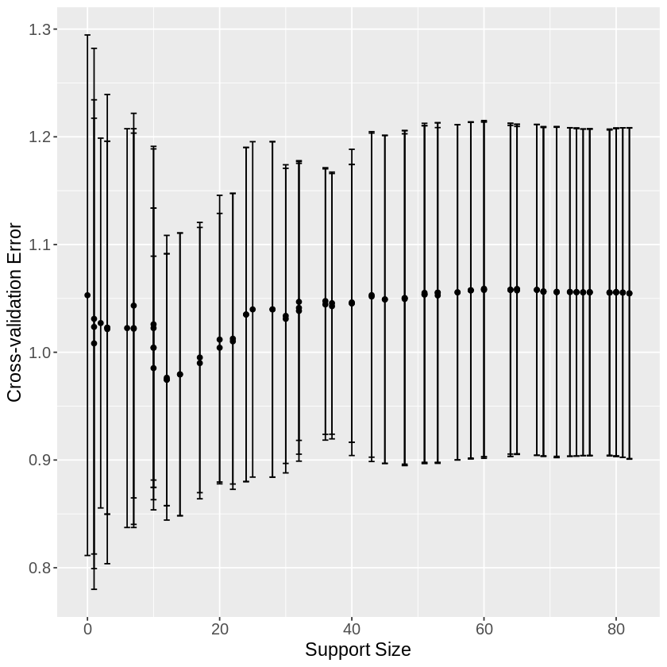
L0L1 Penalty (p=500)
Chosen Gamma Value: 5.062917e-05
Good Lambda Value: 1.70202e-02
Support Size for config: 10
Overall Accuracy: 0.96
Conf matrix (p = 500) | positive | negative
positive | 25 | 1
negative | 1 | 23

Slide 22
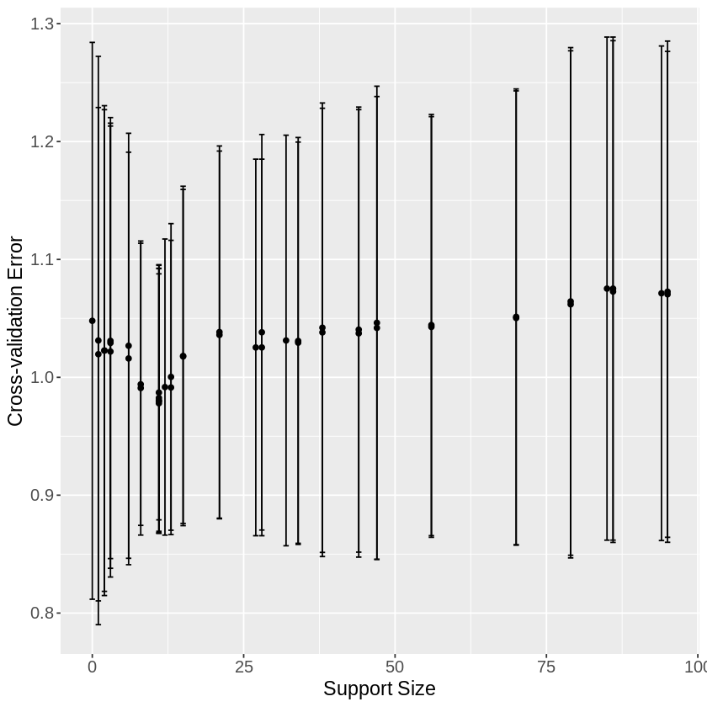
L0L2 Penalty (p=500)
Chosen Gamma Value: 2.154435e-01
Good Lambda Value: 1.18980e-02
Support Size for config: 10
Overall Accuracy: 0.88
Conf matrix (p = 500) | positive | negative
positive | 25 | 5
negative | 1 | 19

Slide 23
Conclusion
By using the optimum subset selection algorithm, L0 Learn can identify a subset of active SNP. We use regularization to reducing overfitting.
In fact, L0 Learn has been shown to achieve high accuracy of up to 0.96%, especially in situations where the data is sparse and not enough parameters are provided.
We see that where Lasso fails at selecting the correct coefficients, L0 Regularization performs extremely well at doing the same.
Notes:
REVISIT!

Slide 24
References
https://www.rdocumentation.org/packages/stats/versions/3.6.2/topics/glm
https://cran.r-project.org/web/packages/L0Learn/index.html
https://cran.r-project.org/web/packages/glmnet/index.html
https://jmlr.csail.mit.edu/papers/volume22/19-1049/19-1049.pdf
https://eight2late.wordpress.com/2017/07/11/a-gentle-introduction-to-logistic-regression-and-lasso-regularisation-using-r/

